Slide 1
Natural Disaster
Trends Analysis
By Scott Burstein
Notes:
Hi everyone. My name is Scott, I’m a junior studying environmental science, and for my final project I chose to research natural disasters as a social force, specifically in the United States.

Slide 2
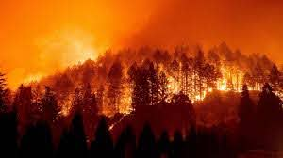
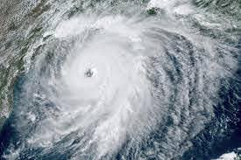
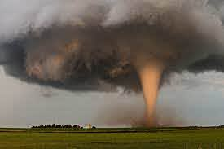
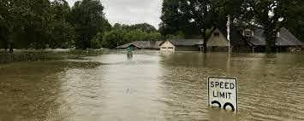

Background
Notes:
First a little background:
The U.S. experience a large variety of natural disasters each year: hurricanes, tornadoes, wild fires and floods, which are among the events that endanger many lives and cause billions of dollars in damages.
The Federal Emergency Management Agency is in charge of "helping people before, during, and after disasters" by coordinating disaster response and providing relief funds.

Slide 3
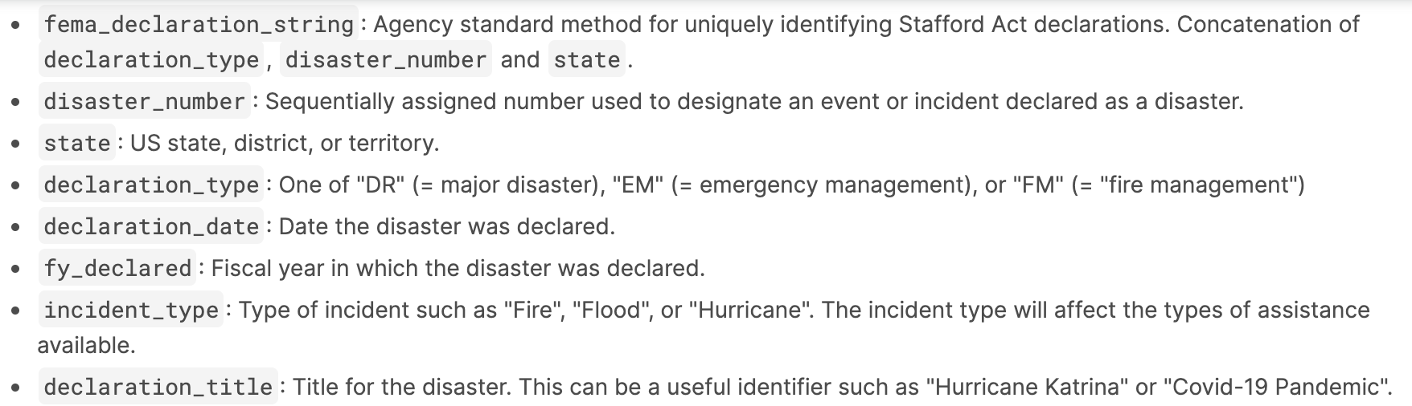
Data
From Kaggle: https://www.kaggle.com/
US Natural Disaster Declarations (FEMA)
Notes:
The dataset I am using is from Kaggle, and it is a compilation of all FEMA declarations since 1953 to the present.
I have specifically been using the variables state, declaration_date, incident_type and declaration_title for my analysis.
Also, While it is not a focus of my research, I thought it is interesting to note that the dataset does also include COVID-19 emergency declarations, which are classified as biological disasters.

Slide 4
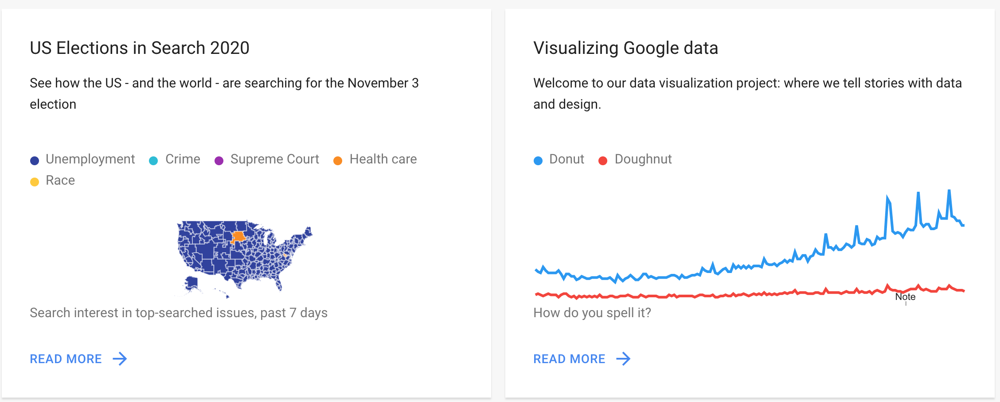
Google Trends
https://trends.google.com/trends/?geo=US
Notes:
I am using the gtrendsR package, which is an interface for retrieving and displaying the information returned online by Google Trends queries.
Trends can be tracked by viewing the number of “hits” for specific search terms over designated time and geographic boundaries.
If you are unfamiliar, I highly recommend you take a look at the google trends website. It is really interesting. These are some of the latest stories and insights I found when I looked this morning.

Slide 5
Research Question
Does interest in climate change increase regionally after the occurence of a natural disaster?
Additionally, do Google search patterns correlate with real-world events?
Notes:
My primary research question is: does interest in climate change increase regionally after the occurrence of a natural disaster?
And in a more general sense, do google search patterns correlate with what is happening in the real world?

Slide 6
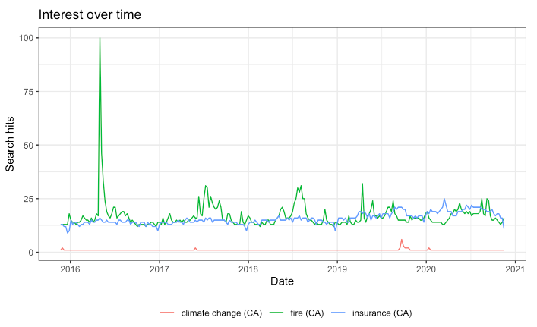
Interest Over Time Visualizations
Notes:
Graphing interest over time in California for “fire”, “climate change” and “insurance”. The interest is scaled such that there will always be a relative “100” value. In this case, the most searched term was “fire” on May 1st 2016, which was not the date of any major wildfire, but rather the last day to obtain a burn permit in southern California for that year, which I think caused the spike. This shows the need for more thorough analysis. The problem with this visualization though is that it dwarfs all the other values for topics like climate change.
I also plotted interest in “insurance” to see if there was any correlation with “fire” - to no avail.

Slide 7
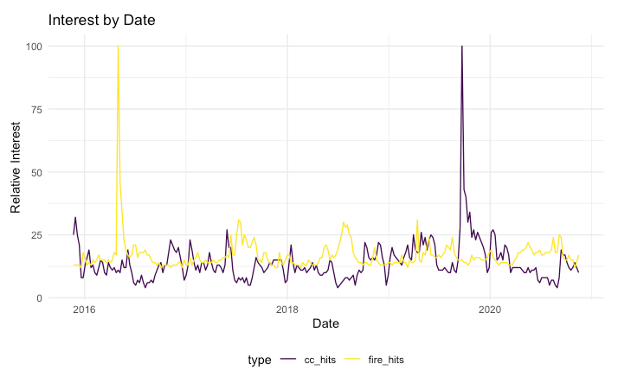
Interest Over Time (continued)
Notes:
This plot shows an important breakthrough I had in my research - being able to plot multiple topics on the same graph with independent “100” hit values. So now we can see what is happening to search volume for “climate change” in more detail.
This is the result for california search hits over the past 5 years for climate change and fire search terms. Like the last line graph showed, “fire” search hits peaked on May 1st, 2016. But now we can also see that climate change search hits peaked on September 22nd 2019, the week of the 2019 global Climate Strikes which swept the world.
It is also sadly (at least for my research’s sake) evident that, at least for wildfires, there is not a clear correlation between the occurrence of a fire, and search volume for climate change. Although looking closely though at the two lines it seems there generally is a spike in climate change hits after a spike in “fire” hits. From a social science perspective, I need to think more about why there is a lack of causality, and what other factors may be important to consider.

Slide 8
Questions? Feedback?
Thank you!

